Slide 1

How to invest in movies?

Slide 2

Genre
WHAT AFFECTS RATING ＆
PROFITABILITY OF A MOVLE
Release time
Studio
Name
Director, Actor, Writer...
Box Office Moio
DATA
SOURCES
IMDB
Rotten Tomatoes
TheMovieDB.org

Slide 3
PART 01
Genre

Slide 4
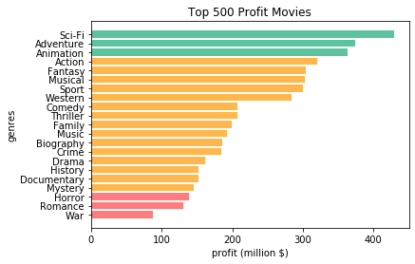

GENRE
Top 3：
Bottom 3：
Sci-Fi
Adventure
Animation
War
Romance
Horror

Slide 5
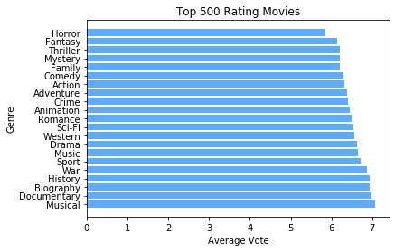

GENRE
Top 3： Bottom 3：
Musical
Documentary
Biography
Horror
Fantasy
Thriller

Slide 6
PART 02
12
9
.
3
6
Release Time

Slide 7

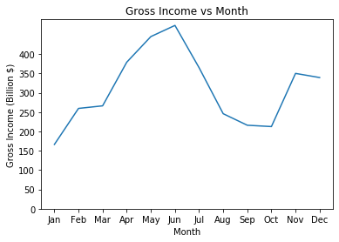
Release Time
Clearly the Release
Time has a big impact in Gross Income

Slide 8
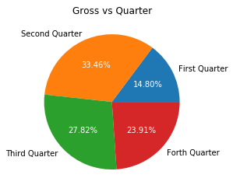
Release Time
Let’s separate the year quarterly
1st Quarter: Average $692.21 million
2nd Quarter: Average $1298.82 million
3rd Quarter: Average $826.95 million
4th Quarter: Average $902.21 million

Slide 9

PART 03
Studio

Slide 10

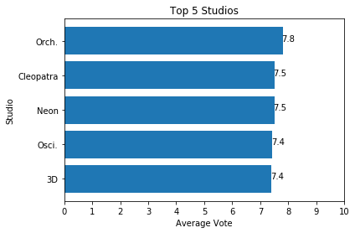

Studio
In reputation, the average rating of movies from top 5 studios are close to each other

Slide 11
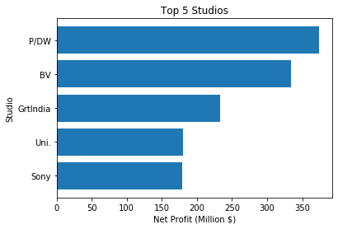
Studio
Though P/DW and Sony are both top 5 studios in profit per movie, invest in P/DW is likely to receive much better return than invest in Sony

Slide 12
Conclusion
Release Time has a big impact in gross income. In order to gain better return, movie should be release in mid-summer or mid-winter
Profit and Reputation are not actually relevant. If the purpose is for better return, Sci-Fi/Adventure/Animation are the top 3 genres to be invest in. Avoid invest in the bottom ones. Although there are no huge difference in ratings, Sci-Fi’s return is almost 4 times to Horror movie.
Choose wisely from the top studios. P/WD is a good choice.

Slide 13
THANK YOU

